Slide 1

Gratitude++ Update Presentation
By
Joel Scott
Benjamin Seifried
11/13/2023

Slide 2

Agenda
Overview
Deviations from Initial Design
Accomplishments
What’s Left
Unresolved Issues
Conclusion

Slide 3

Overview
The development of the Gratitude++ application has closely followed initial design documentation

Slide 4
Some deviations were necessary​
For function​​​
As technology stacks were incorporated​​​
As needed to ensure timely deployment​

Slide 5

This presentation will explore some of that process and conclude with overall project outlook

Slide 6

Project Changes
Modal Usage Reduced
Navigation Changes
User Information Displayed
Page Formatting Changes
User Input Limited

Slide 7

Work Completed

Slide 8
Authentication
Database Integration
Hosted On Server

Slide 9

Navigation​​
Journal Entry Creation​​
Entry Displays​​
Most Pages Display as Intended

Slide 10
Work In Progress
Community Entry Flagging
Resource Page
Confirmation Modal Integratons

Slide 11

Work In Progress
Account/Entry Deletion
Search Functions
Additional Page Displays

Slide 12
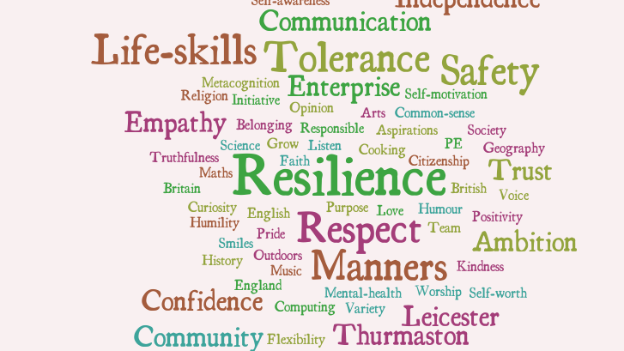
Work In Progress
Word Cloud Component Implementation
Security Rules
Finalized Stylings
This Photo by Unknown author is licensed under CC BY-NC-ND.

Slide 13
Unresolved Issues
Data Base Security Rules
WordCloud Implemenation

Slide 14
Conclusion
While the project up to this point has been both educational as well as challenging...
the overall outlook for successful completion of the Gratitude++ Journal Application ahead of the release deadline...

Slide 15

...is Good

Slide 16
Thank You

